Slide 1
Annual Business Insights
Ajay
JULY,22 , 2025
Analysis Department
Notes:
Line spacing + Page numbers

Slide 2
Agenda
01 Introduction
02 Initial Sales Analysis
03 Why Sales Are Low?
04 Key Insight & Analysis
05 Solutions
06 Conclusion

Slide 3
Introduction
01

Slide 4
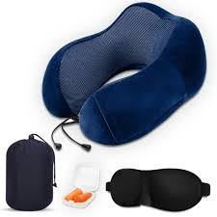
Introduction
01
Smart pillow is an Innovative neck support pillow with vibration massage technology.
The production was launched with high production output and performing market share .
However, the first sales batch underperformed with negligible sales despite marketing efforts.

Slide 5
Initial Sales Analysis
02

Slide 6
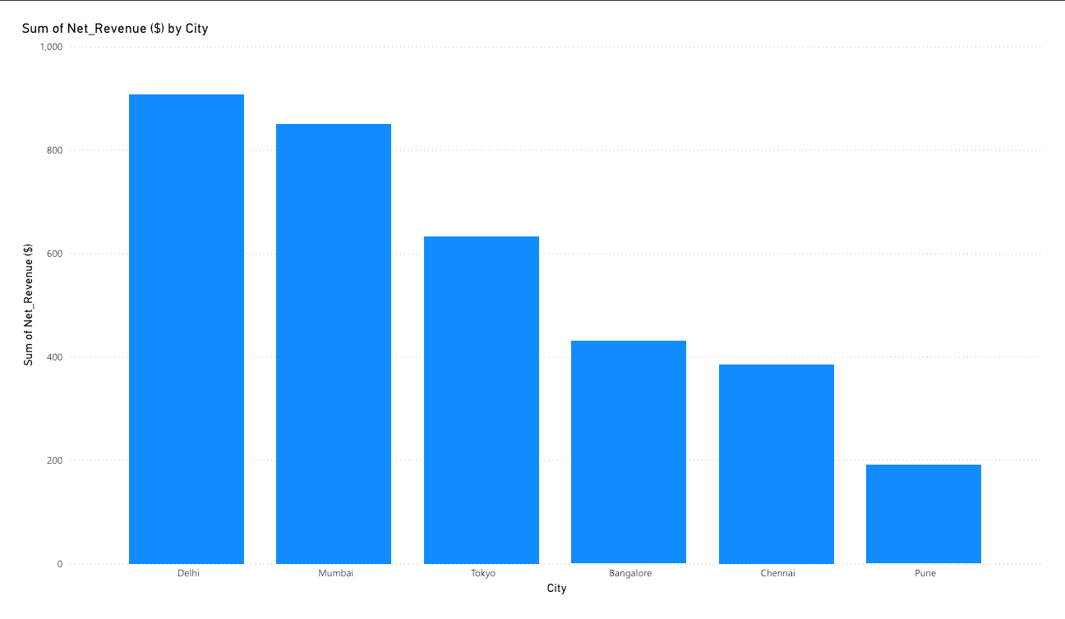
Revenue By Cites

Slide 7
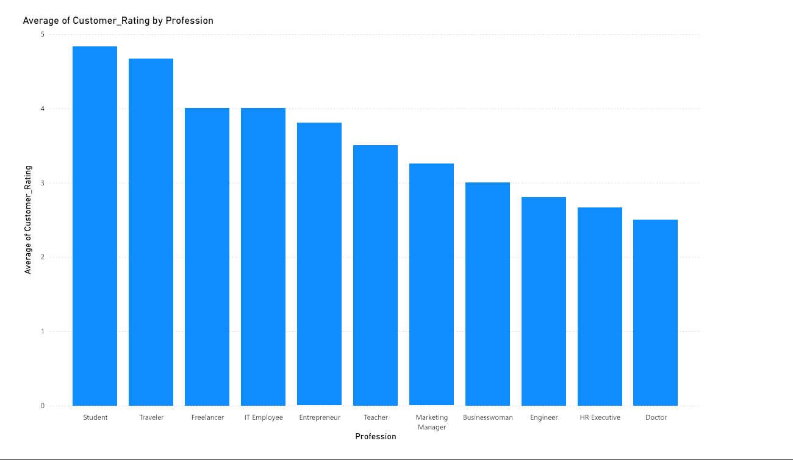
Average costumer Rating

Slide 8
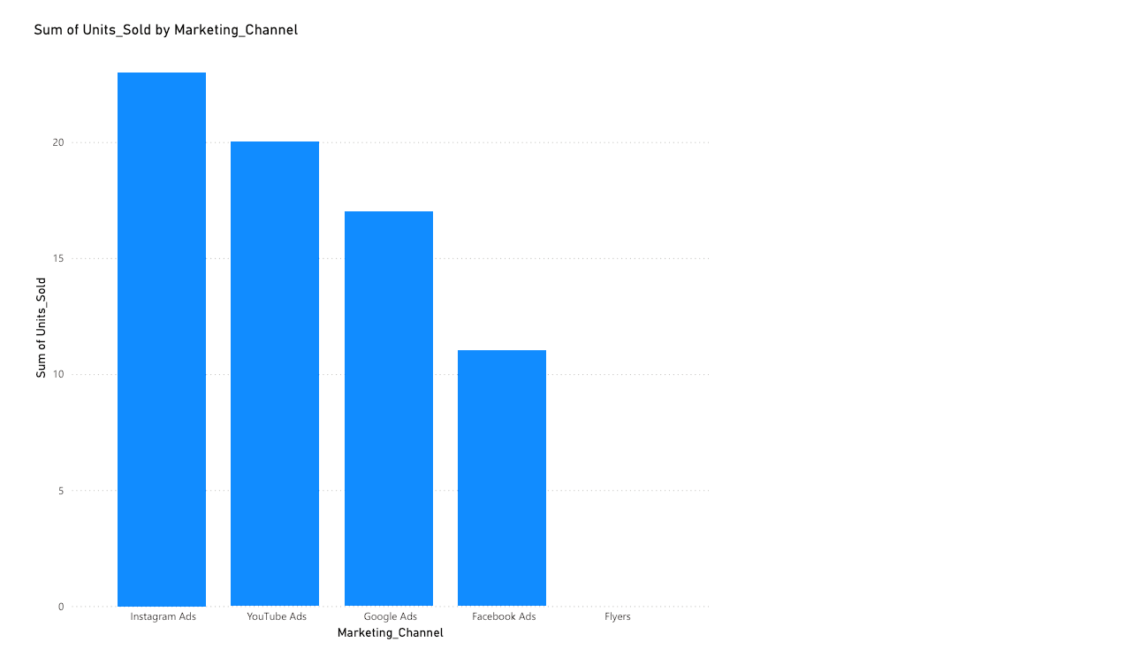
Sales Source

Slide 9
03
Why Sales Are Low?

Slide 10
Why Sales Are Low?
03
Product Availability Issues : Many customer reported that the product was not available to purchase at a time of demand
Delivery delays : Negative feedback due to slow or unreliable delivery.
Limited offline presence: No visibility in physical stores reduced trust and impulse purchases.
Pricing confusion : Some users mentioned unclear or high pricing due to discounts not being applied correctly.

Slide 11
Insights & Target Audience
04

Slide 12
04
Key Insights from Analysis
Top Cities which gave the most sales:
Delhi
Mumbai
Tokyo
These three cities generate most of the revenue.
Total combined revenue : 60%
60%

Slide 13
04
Key Insights from Analysis
Marketing Channels :
The Channels produce and influence people to buy the product :
Marketing Channels | Percentage
Instagram | 45%
YouTube | 35%
Others | 20

Slide 14
04
Key Insights from Analysis
Target Audience : People who buy the product most and generating the revenue .
People of this age group showing most Interest in the product .
These people are most students and young professional .
Age group | 28 – 32

Slide 15
04
Key Insights from Analysis
Top Professions : People from different profession are showing their interest in the project ,So those professions are :
Professions | Percentage
IT professionals | 45
Students | 25
Corporate Employees | 15
Freelancers | 10
Others | 5

Slide 16
Possible Solutions
05

Slide 17
05
Possible Solutions
Fix Product Availability:
Ensure Stock is easily available on all major e-commerce platforms.(Amazon ,Flipkart)
Availability at Local market places:
Partner with local offline stores in metro cities and small towns or suburban areas.

Slide 18
05
Possible Solutions
Focused Marketing Strategy :
Double down on Instagram & YouTube campaigns (proven high conversion)
Use influencer marketing In Top cites which are giving most of the sales.
Use on site campaigns in Suburban area to promote the product to more people or costumer.

Slide 19
05
Possible Solutions
Improvement in Delivery & Pricing Transparency :
Partner with fast and reliable delivery services
Clearly display of pricing and discounts during checkout.

Slide 20
05
Possible Solutions
Feedback & Continuous Improvement ::
Set up monthly surveys to track customer experience.
Add a “Availability alerts” :
By using Email / SMS to notify them when product is restocked .

Slide 21
Summary
Our business is good Our product have a great Potential | Most value generated places Delhi ,Mumbai ,Tokyo metro cites give business share of 60%
Target Audience Students and IT professionals are our main audience. | Marketing Channels Instagram and YouTube are the channels generated most sales.
We’re delivering for our customers Customer satisfaction is at least 70 -75% | Problem we have to solve Delivery issues and Availability of product.

Slide 22
Closing
06
Thanks to view this project till here .
“Through this project, I understood can drive business growths. This journey reflects my interest in business analysis and my ability to turn challenges into opportunities.”
Ajay

